Slide 1

Customer Shopping Behavior Analysis
3,900 purchases — 18 columns — goal: uncover spending patterns, segments, preferences, subscriptions

Slide 2
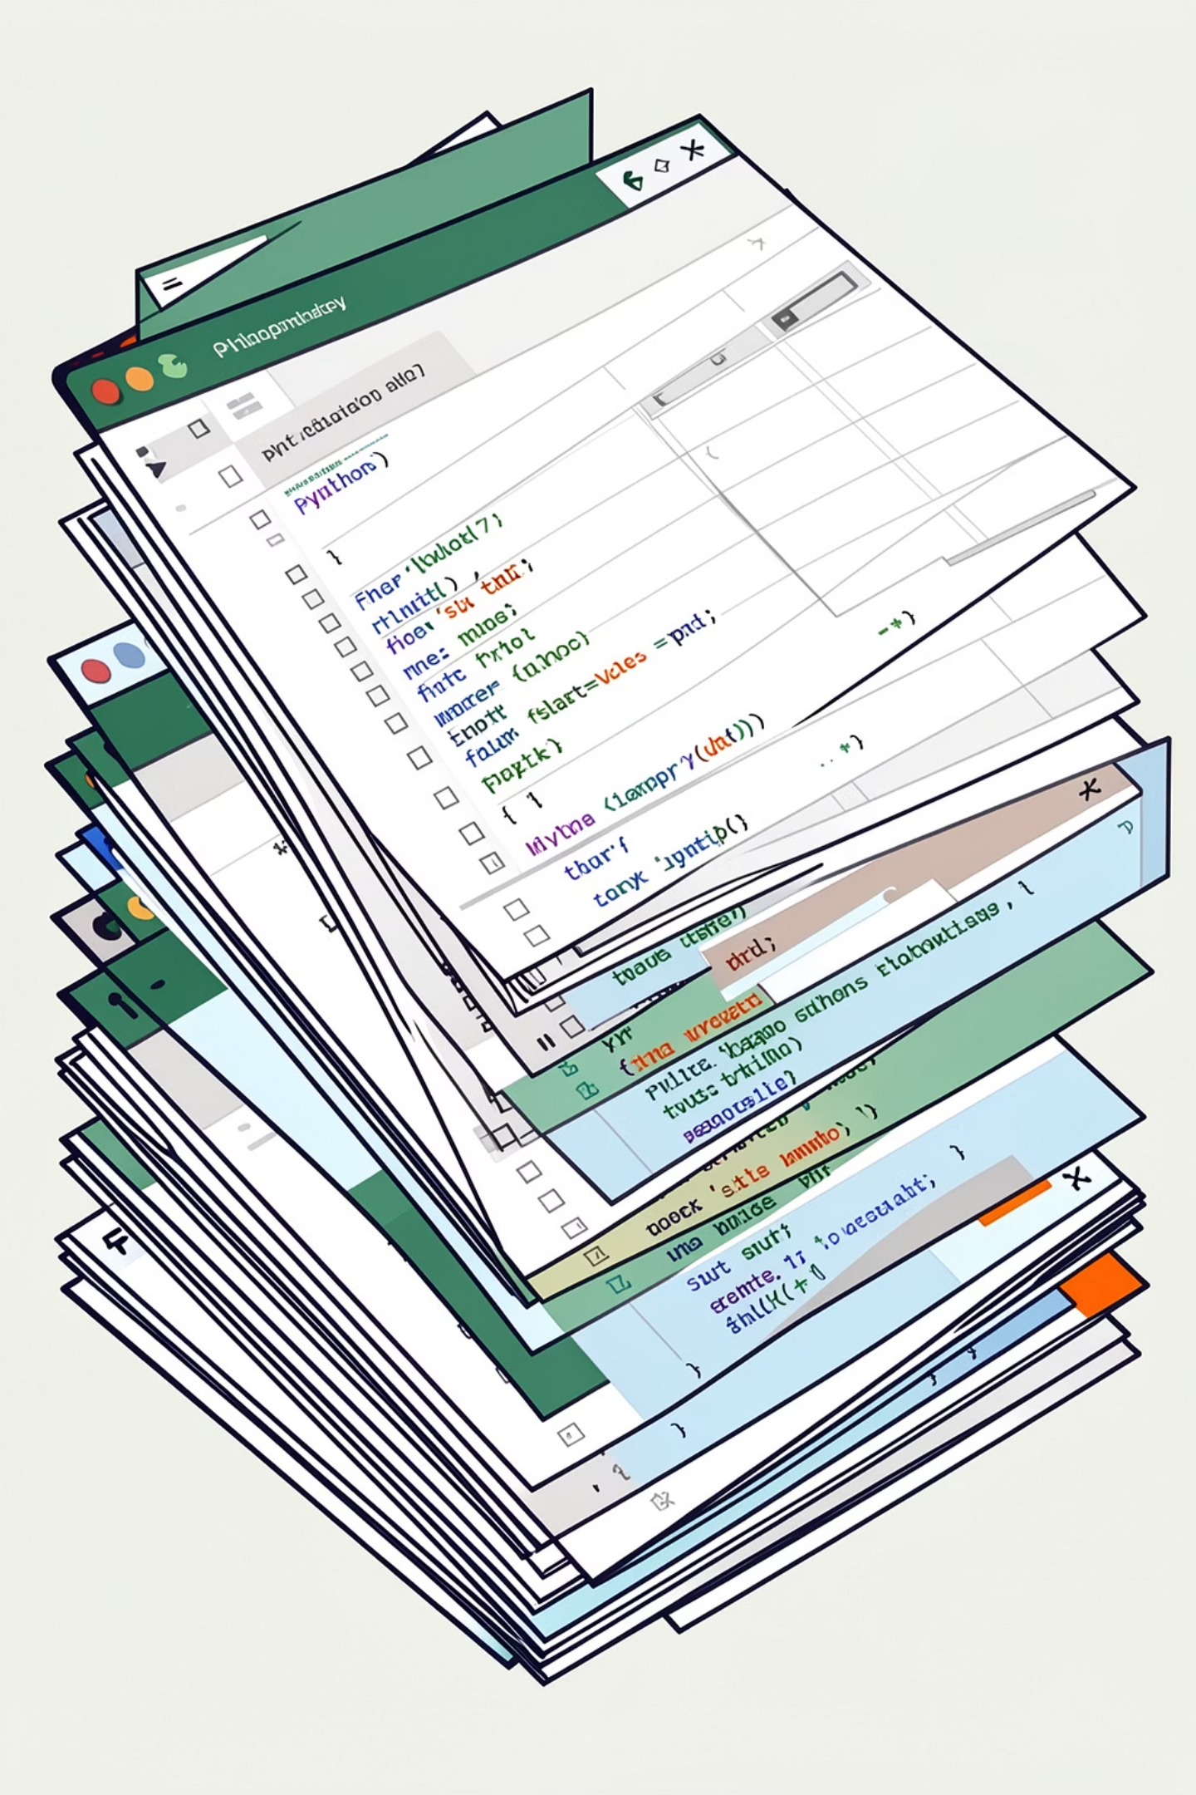
Dataset Summary
Size
Key Features
Rows: 3,900 · Columns: 18
Demographics, purchase details, behavior, subscription
Missing Data
37 missing values in Review Rating

Slide 3
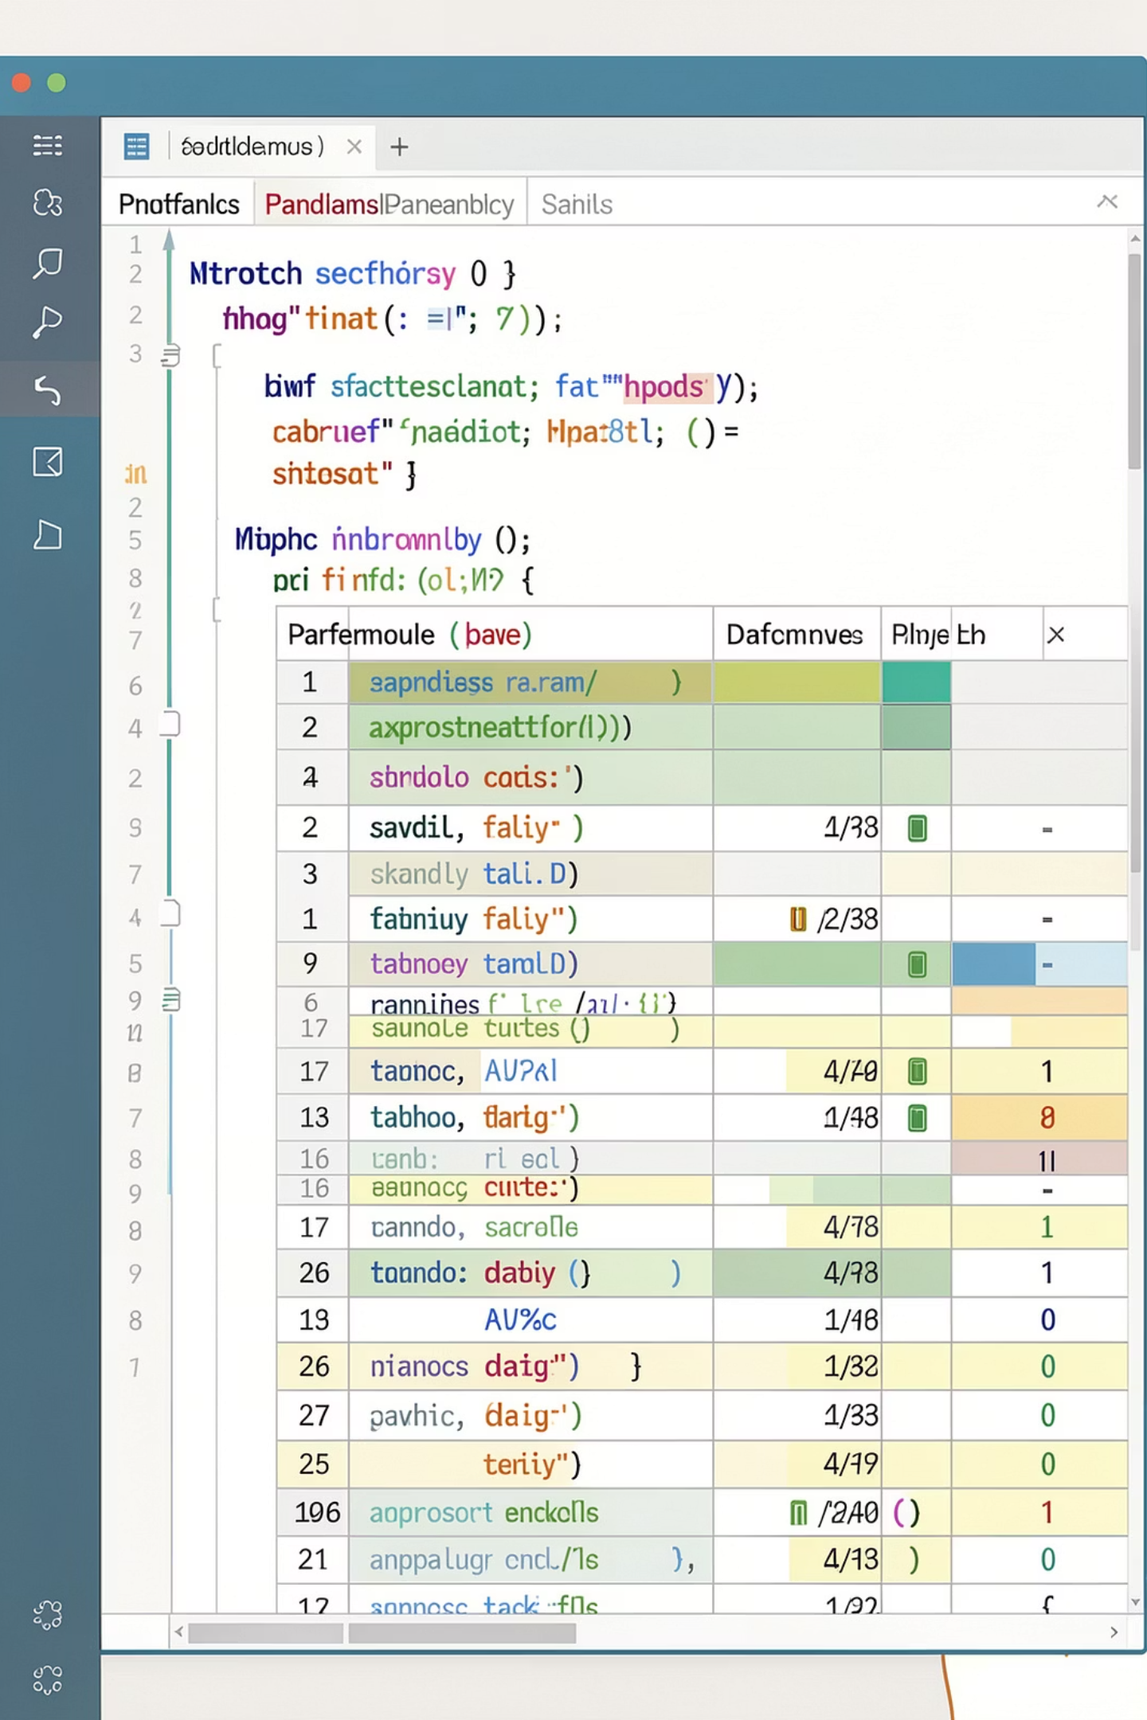
Exploratory Data Analysis (Python)
01
Load & Inspect
df.info(), .describe()
02
Clean
Impute review ratings by category median
03
Engineer
age_group, purchase_frequency_days
04
Finalize
Drop promo_code_used, snake_case columns, load to PostgreSQL

Slide 4

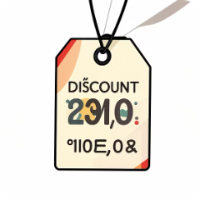

Key Findings
Revenue by Gender
High-Spending Discount Users
Top Rated Items
Female: 75,191 · Male: 157,890
Gloves 3.86 · Sandals 3.84 · Boots 3.82
839 rows identified — many above-average spends despite discounts

Slide 5

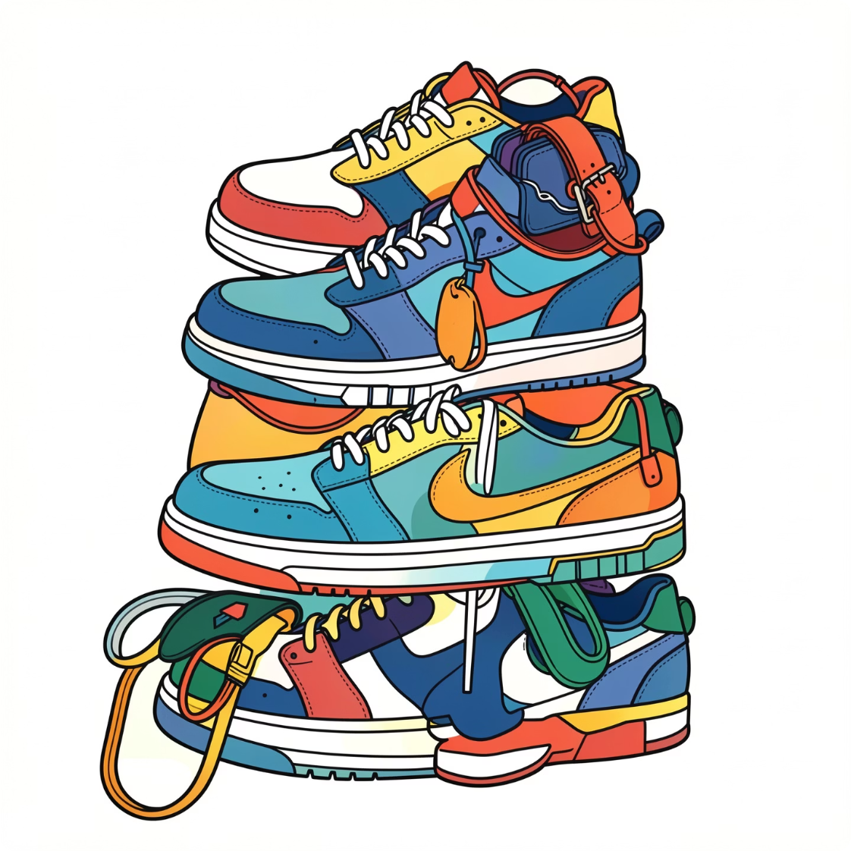
Product & Shipping Insights
Shipping Comparison
Standard avg $58.46 · Express avg $60.48
Discount-Dependent
Top: Hat 50% · Sneakers 49.66% · Coat 49.07%
Top Products by Category
Accessories: Jewelry, Sunglasses, Belt · Clothing: Blouse, Pants, Shirt

Slide 6
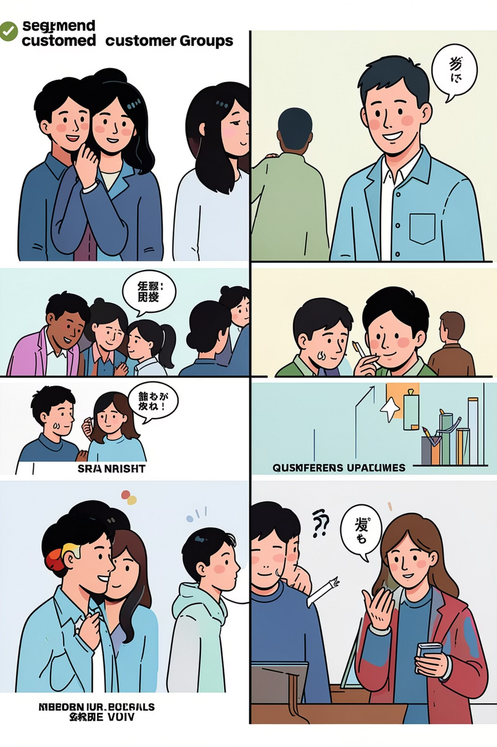
Customer Segmentation
Loyal
Returning
3,116 customers
701 customers
New
83 customers

Slide 7
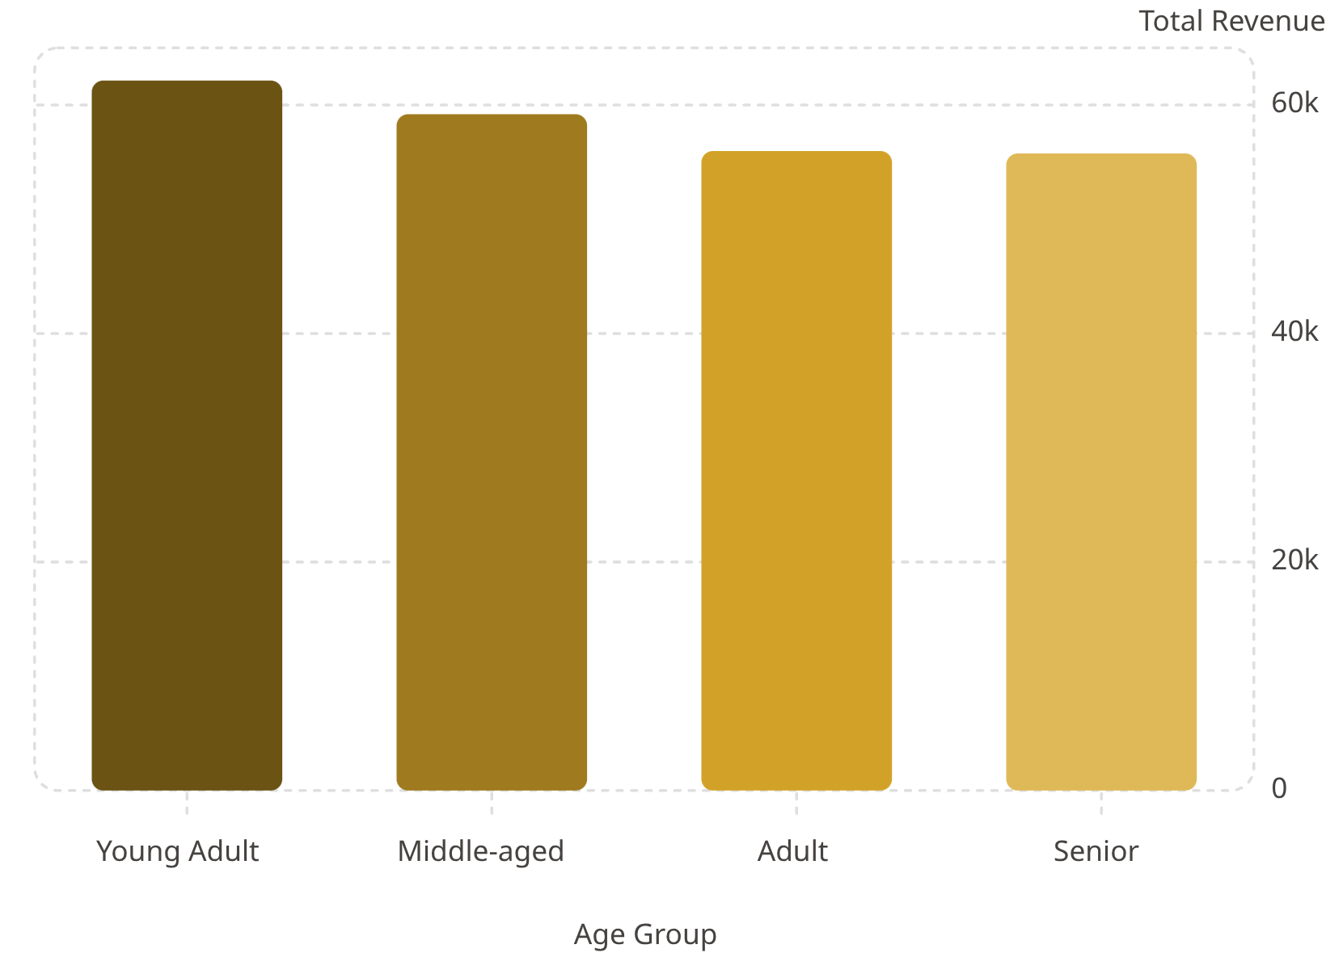
Revenue by Age Group
Focus marketing on Young Adult & Middle-aged segments — top revenue contributors
Average purchase ~$59.76 · Avg rating 3.75

Slide 8
Business Recommendations
Boost Subscriptions
Loyalty Programs
Review Discount Policy
Product Positioning
Promote exclusive subscriber benefits
Reward repeat buyers to increase loyalty
Balance promotions with margins
Highlight top-rated & best-selling items
Targeted Marketing
Focus on high-revenue age groups & express-shipping users

